Slide 1
TextComponents and Trees
CS 5100
Lecture 16

Slide 2
The JTextComponent Hierarchy
Implements a great deal of functionality
  cut, copy, paste
  editor commands, text selection
  keymaps
  caret position
  document model
  stream I/O
  (x,y) points associated with offset positions
JTextComponent is the abstract base for 5 other concrete derived classes

Slide 3
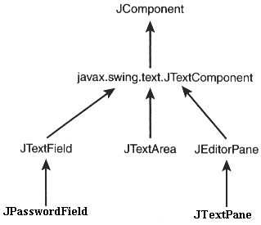

Slide 4
JTextField
Constructor can take document, string, cols
Horizontal
  Alignment
  Visibility
  Scroll Offset
Action Command
JPasswordField
  echo character
  getPassword

Slide 5
JTextArea
Constructor can take document, string, rows, columns
Line wrapping, at words or characters
Line Operations
  getLineCount
  getLineEnd(Start)Offset and getLineOfOffset
insert, append, replaceRange
setTabSize

Slide 6
JEditorPage
Standard text types are ASCII, HTML, RTF
Editor kits for these or other types
Constructor takes
  URL
  MIME type and string
  string name of URL
Initialize with setPage, setText, or read
Hyperlink events are detected

Slide 7
JTextPane
Permits multiple styles in a single document
Can embed images (icons) and other objects
Construct with a standard document model
Individual text snippets inserted with styles
  Get the Style Context
  Then get a named variant of the default style
  Then setFamily, setFont, setItalic, etc.
  Then add it to the JTextPane
Get style attributes for character, paragraph

Slide 8
JTree
A huge class for directory trees, documents, etc.
Constructor takes a TreeNode, TreeModel, an Object array, a vector, or a hash table
Tree nodes identified by path or row
  Can be expanded or collapsed
  Can translate between row, path, & (x,y) point
  All sorts of selection operations are possible
  Root node may or may not be visible

Slide 9
Auxiliary Tree Classes
TreePath
TreeNode
TreeModel
TreeCellRenderer
TreeModelEvent
TreeExpansionEvent
TreeSelectionModel
TreeSelectionEvent
TreeWillExpandListener

